Slide 1

Protect and Serve
Alexis Bates, Claire Boudreau, Elisa Elsesser, Laura Espinosa, Manuel Kent, Jackie Lu, Grace Taylor

Slide 2

Program Overview
This program is designed to help the Chicago Police Department create optimized schedules.
To optimize the schedule the following factors are taken into consideration
Total number of officers available
Desired number of patrol units (clusters)
User Specified crime severities

Slide 3
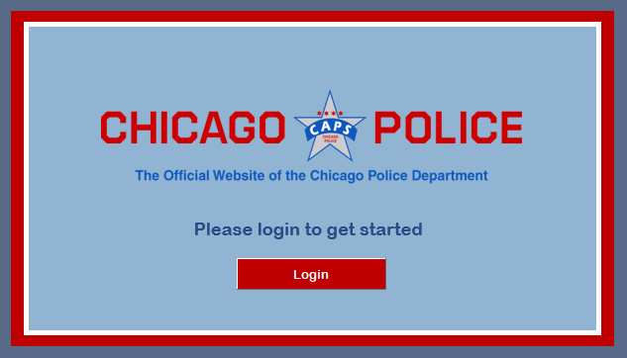
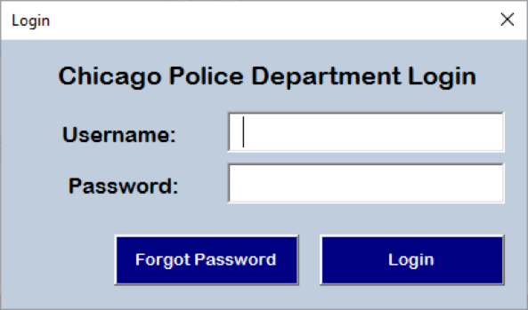
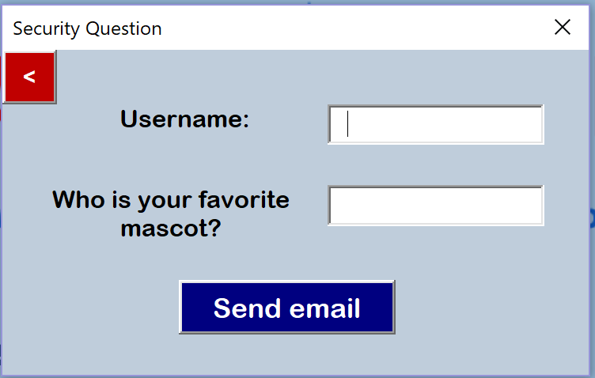
Login

Slide 4
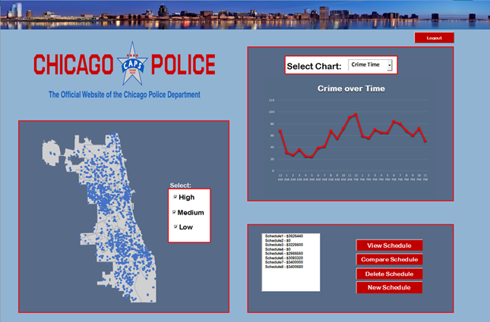
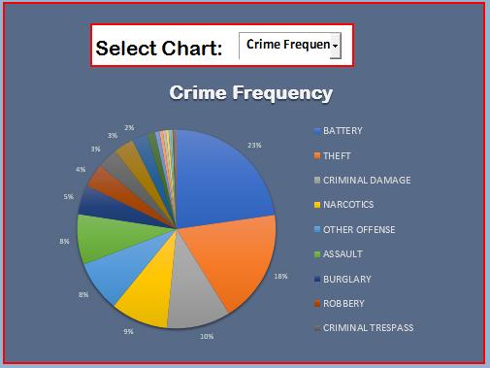
Main Dashboard

Slide 5
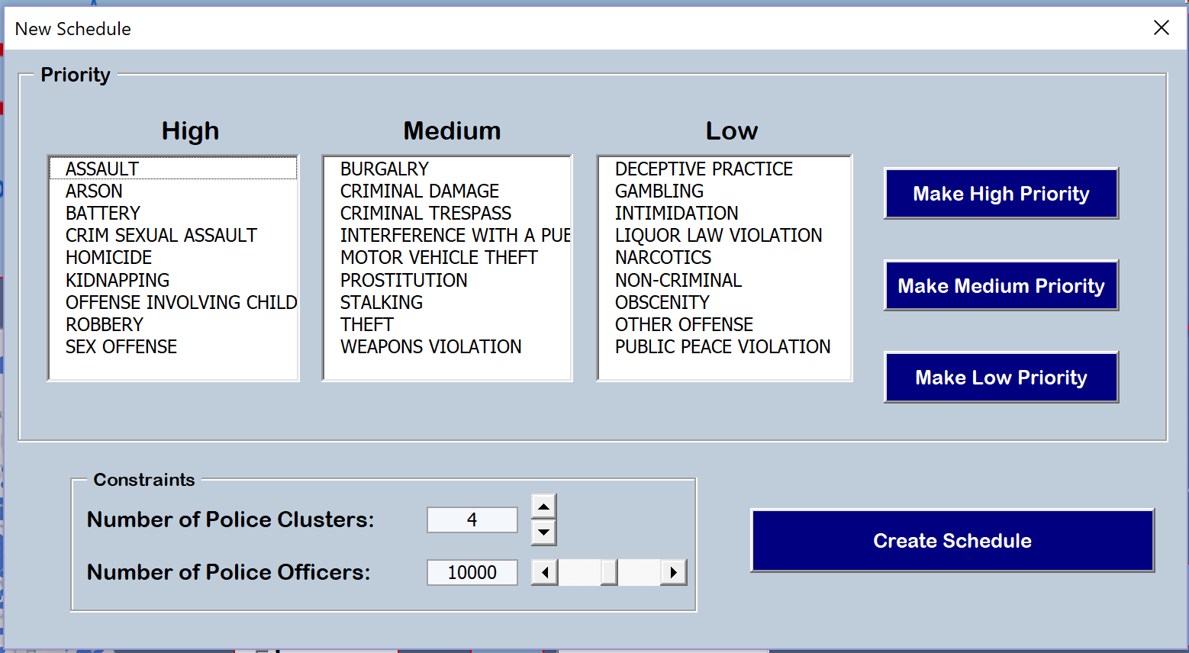
New Schedule

Slide 6
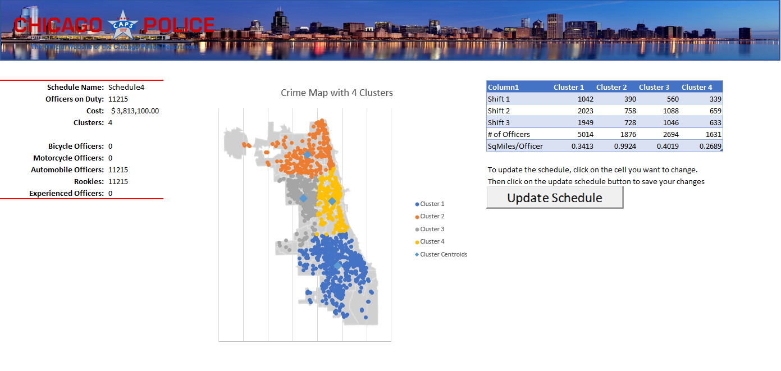
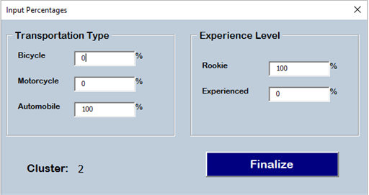
New Schedule

Slide 7
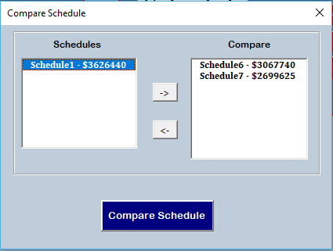
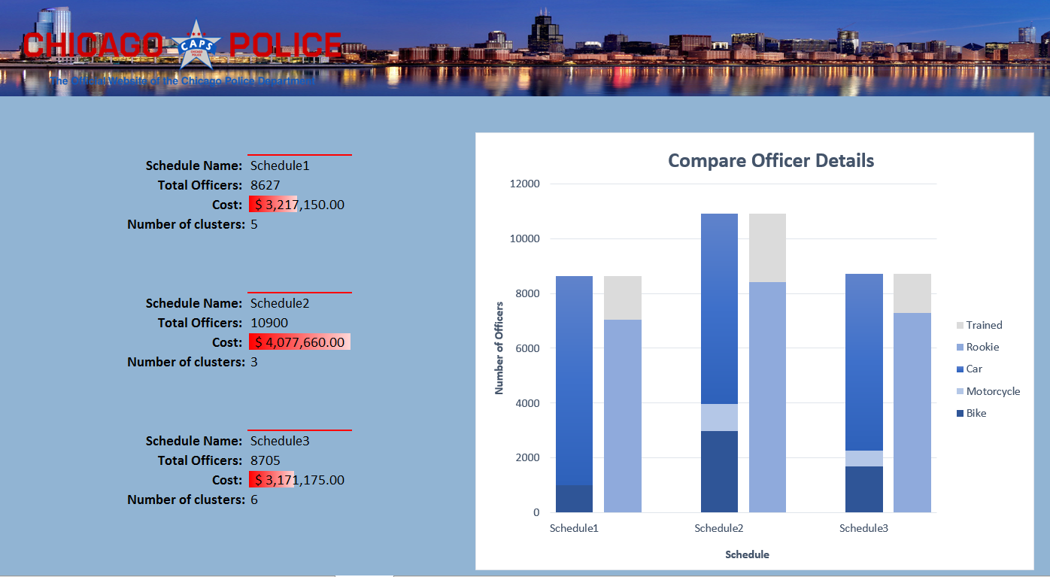
Compare Schedule

Slide 9
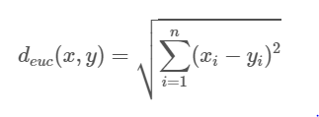
Methodology
K-Means
Choosing a series of centroids (one centroid per cluster)
Groups the nearby crimes based on the distance (x and y values)
of the point to the centroid.
Chooses the series of clusters that aims to minimize
the intracluster Euclidean distance.
The algorithm stops when once the iteration number reaches max iteration value.
Resource Allocation
Assign a weighted average to a cluster based on an average of severity of crimes
Officers are allocated based on average (higher averages mean more officers)

Slide 10
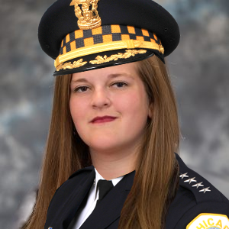
Questions?

